Slide 1

FUNCTIONS
FUNCTIONS

Slide 2
What is a function?
Defining a function
Passing information to a function
Return values
Passing an arbitrary number of arguments
Storing our functions in modules
Exercise
List of Content
We will learn to write functions, which are named blocks of code that are designed to do one specific job.

Slide 3
What is a Function?
Functions are blocks of code / instruction that are designed to do one specific job, for example:
displaying information (texts / plots)
processing data and returning a value or set of values
By using a function, we don’t need to type all the same code for the same task repeatedly. Thus, it makes our programs easier to write, read, test, and fix.

Slide 4
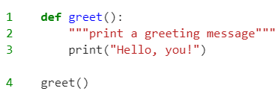
Defining a Function
line 1 is what is called function definition. It tells Python the name of the function and the information it needs to do its job. It starts with the def keyword, followed by the name of the function, then parentheses that hold the information (in this case, the greet function needs no information), and ends with a colon. Any indented lines after this, is called the function body.
line 2 is a comment called docstring. It is enclosed in triple quotes. It describes what the function does, the information it needs (if needed), and the returned values (if any). It is a good practice to always write a docstring when you define a function.
line 3 is the actual code / instructions.
line 4 is the function call. After we have defined a function, we need to call it to do its job. We just need to write the function name and the information it needs.

Slide 5
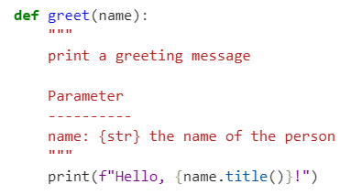

Passing Information to a Function
The information is written inside the parentheses. For example we want to greet someone by his/her name. The name is the information the function needs, so we need to put it into the parentheses. We need to modify the function slightly as well.
We put a parameter into the function definition.
we modified the docstring, so the user can understand what parameters and their associated types of data needed to tun the function.
we modified the code so it can print the titlecased name.
Function call

Slide 6
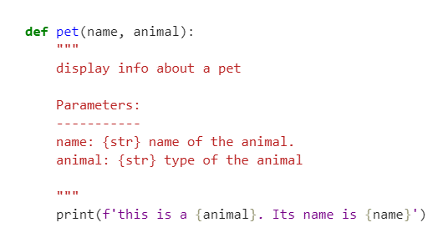
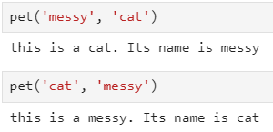
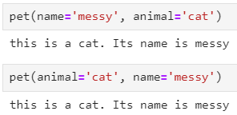
Passing Information to a Function
Positional Arguments
The order of arguments in the function call must match the order of parameters in the function definition
Keyword Arguments
name-value pairs. The order does not matter.

Slide 7
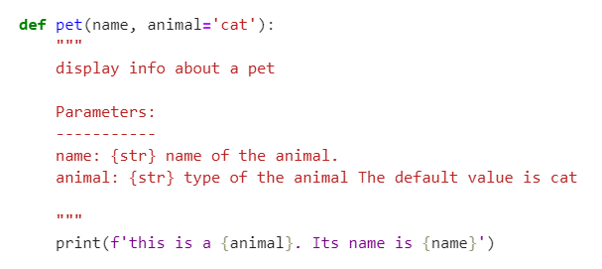

Passing Information to a Function
Default values
We set ‘cat’ as the default value for the animal parameter. So we don’t need to pass an argument for the animal parameter. However, we can overwrite the argument by passing another value.

Slide 8
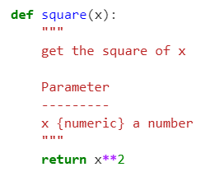

Return Values
Here is a function to get the square of x. We can use the return keyword to get the square of x out of the function and assign it to a variable.
For example, we assign the square of 4 to variable y.

Slide 9
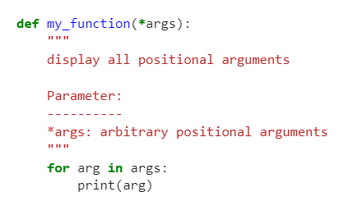
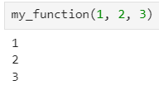
Passing an Arbitrary Number of Arguments
*args (arbitrary positional arguments) and **kwargs (arbitrary keyword arguments) are special syntax used in function definitions to handle variable numbers of arguments.
*args :
allows a function to accept an arbitrary number of positional arguments.
Is used when the number of positional arguments that the function will receive is not known beforehand.
Inside the function, *args is treated as a tuple that holds all the additional positional arguments passed to the function.

Slide 10
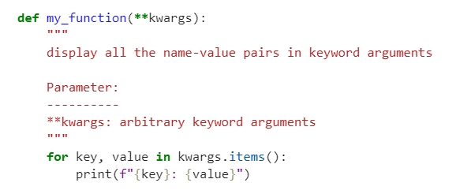
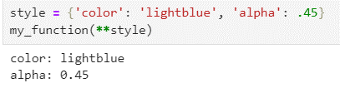
Passing an Arbitrary Number of Arguments
*args (arbitrary positional arguments) and **kwargs (arbitrary keyword arguments) are special syntax used in function definitions to handle variable numbers of arguments.
**kwargs :
allows a function to accept an arbitrary number of keyword arguments.
Is used when the number of keyword arguments that the function will receive is not known beforehand.
Inside the function, **kwargs is treated as a dictinary that holds all the additional keyword arguments passed to the function.

Slide 11
Storing our Functions in Modules
We use modules to break down large programs into manageable and organized small files. It is better to define the functions that we use frequently into a module and call them when needed in many other programs, than to define or copy-paste these functions into many programs. Storing our functions in modules allows us to focus on the higher-level logic of our programs. Module is a file containing python code.
For example, visualization.py is a module named " visualization".
program_1
module_a.py
function_a1
function_a2
ClassA
package
program_2
module_b.py
function_b1
function_b2
ClassB
program_3

Slide 12
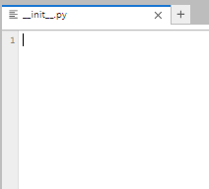

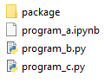
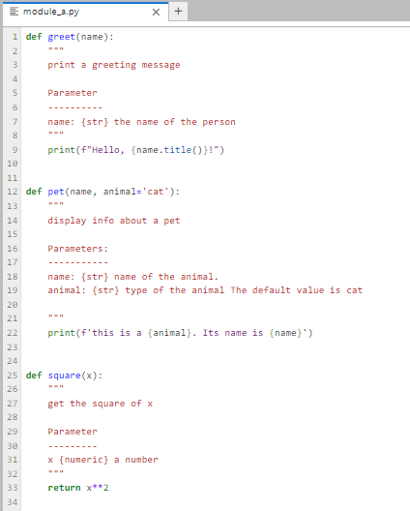
Storing our Functions in Modules
An empty __init__.py file is still necessary to mark a directory as a package, but it doesn't have to contain any code.
Our custom Python package
Our module comprises custom functions, classes, variables, etc.
Python programs that will import our modules

Slide 13
Exercise-1

Slide 14
OBJECT-ORIENTED PROGRAMMING
(CLASSES)

Slide 15
What is a class?
Creating and using a class
Working with classes and instances
Inheritance
Exercise
List of Content
We will learn to write classes. Classes combine functions and data into one neat package that can be used in flexible and efficient ways.

Slide 16
What is a Class?
In Python, a class serves as a blueprint for creating objects (also known as instances). It defines a set of attributes (variables) and methods (functions) that the objects created from the class will have.
In object-oriented programming you write classes that represent real-world things and situations, and you create objects based on these classes. When you write a class, you define the general behavior that a whole category of objects can have.

Slide 17
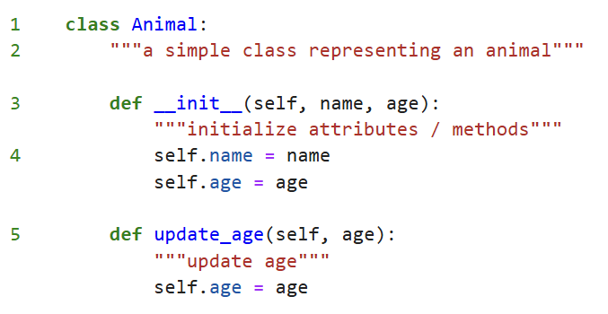
Creating and Using a Class
line 1 is what is called class definition. By convention, classes in Python use CamelCase style. There are no parentheses in the class definition because we’re creating this class from scratch.
line 2 is a comment called docstring. It is a good practice to always write a docstring when you define a class.
line 3 is a special method __init__. A function inside a class is called method. Python runs it automatically whenever we create an instance of a class. The self parameter is required in the method definition, and it must come first before the other parameters.
At 4 we define variables (name and age). Variables that are accessible through instances like this are called attributes.
At 5 we define a method update_age. It takes one parameter (age) beside self.

Slide 18
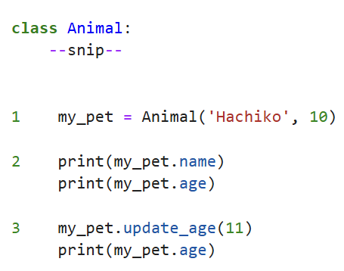

Working with Classes and Instances
At line 1, we create a new instance of an Animal class and assign it to the variable named my_pet. Making an instance from a class is called instantiation, and we work with instances of a class. During instantiation, the __init__ method is automatically called and set the name and age attributes.
At 2, we access my_pet’s name and age attributes and print it. To access those attributes, we just need to write the class name and the attributes separated by dot (.) notation.
At 3, we call the update_age method and print the updated age.
output

Slide 19
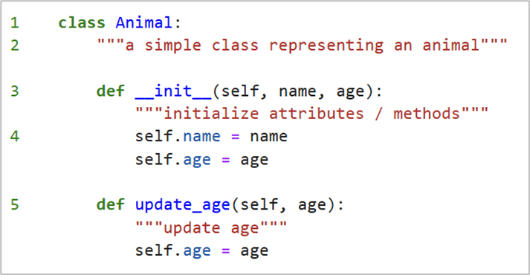
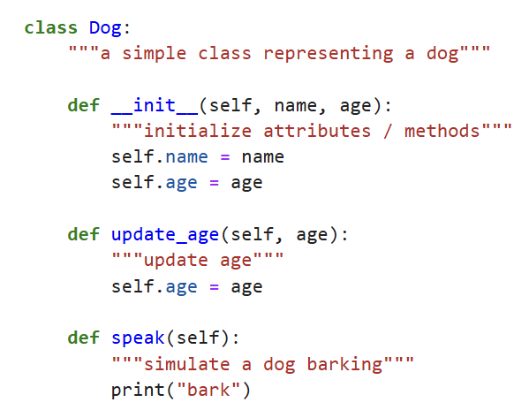
Inheritance
If the class you’re writing is a specialized version of another class you wrote, you can use inheritance. When one class inherits from another, it takes on the attributes and methods of the first class. The original class is called the parent class, and the new class is the child class. The child class can inherit any or all of the attributes and methods of its parent class, but it’s also free to define new attributes and methods of its own.
The difference between the 2 classes

Slide 20
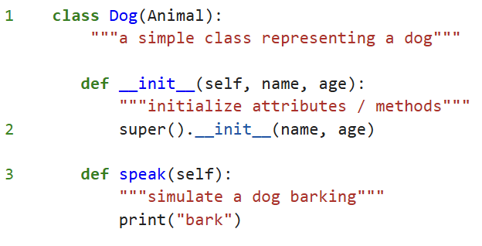
Inheritance
At line 1, we define a new class Dog (i.e. the child class / subclass) which inherits attributes and methods from the Animal class (i.e. the parent class / superclass).
The super() at 2 is used when we want to call a method from the parent class. The super().__init__() method initializes any attributes defined in the parent __init__() method and make them available in the child class.
At 3, we define a new method speak. This method will only be available in the child class

Slide 21
Exercise-2

Slide 22
Machine Learning 101

Slide 23
What is Machine Learning?
Types of Machine Learning
Key Concepts of Machine Learning
Data Science Workflow
Dataset Terminologies
Training, Validation, Testing Dataset
Feature Scaling
Exploratory Data Analysis
Models and Algorithms
Model Evaluation and Validation
List of Content
This outline covers the fundamental aspects of machine learning, starting from basic definitions to practical applications and considerations.

Slide 24
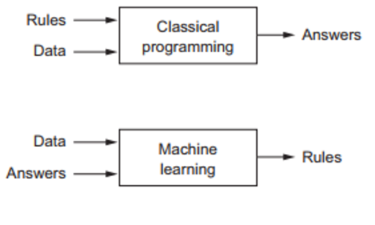
What is Machine Learning?
In classical programming, we enter some rules (programs) and then input some data that will be processed according to these rules to generate answers.
in machine learning model, we feed the input data and the answers associated with that data into the model to generate rules between the input data and the answers. You can apply these rules to a new input data to get an answer to that input data.

Slide 25
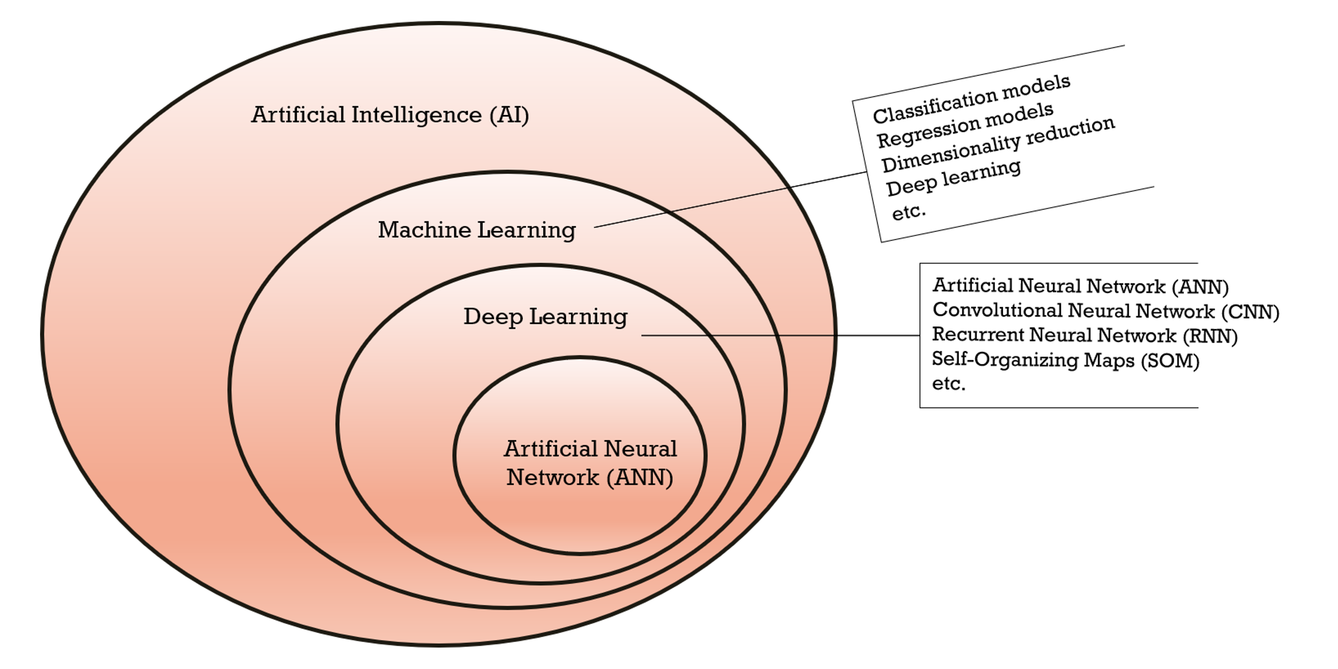
What is Machine Learning?
The relationship between artificial intelligence (AI), machine learning, deep learning, and artificial neural networks (ANN).

Slide 26
Types of Machine Learning
Machine learning
Supervised Learning
Semi-supervised learning
Reinforecement Learning
Classification
Labeled data
(continuous values)
Clustering
Dimensionality reduction
Labeled data
(discrete classes)
Unsupervised Learning
Regression
Unlabeled data
Combine labeled + unlabeled data
Classification
Regression
Association
Rewards & Penalties
Trial-and-error learning process

Slide 27
Types of Machine Learning
Classification
Regression
Clustering
x1
y
x1
x0
x
x0
Label A
Data point
Data point
Label B
Line of best fit
Cluster A
Cluster B

Slide 28
Key Concepts of Machine Learning
Data Science Workflow
Business understanding
Analytical approach
Data requirements
Data collection
Exploratory Data Analysis (EDA)
Data understanding
Deployment
Data preparation
No
Yes
Good enough?
Sufficient?
Model evaluation
Model training
Yes
No

Slide 29
Key Concepts of Machine Learning
Dataset Terminologies
Features
Label
x0 | x1 | x2 | x3 | x4 | y
Features matrix, X
Labels/targets vector, y
1 row = 1 sample
Feature vector
Target for a feature vector

Slide 30
Key Concepts of Machine Learning
Data Preparation
We need to ensure that our data is clean and is in a suitable form so our logic is provided with usable data. No matter how good our logic is, if the input data is incorrect, the results will not be reliable! Just like George Fuechsel, an early IBM programmer and instructor, said
"Garbage In, Garbage Out!"
Here is the list of some potential issues that we need to consider:
Unnecessary samples
Duplicate rows (if any)
Irrelevant features
The possibility of data leakage
The practicability (number of null values, number of unique values, etc.)
The relationship with other features
Incorrect data types
Bad-formatted values
Categorical variables
Incomplete yet useful features
Apart from them, we can also add new features in this step.

Slide 31
Key Concepts of Machine Learning
Data Preparation
Encoding Categorical Variables : used to convert categorical data into a numerical format that machine learning algorithms can process.
Label encoding
involves converting each categorical value into a unique integer (alphabetically).
Red : 2
Green : 1
Blue : 0
Pros & Cons
P : simple and quick to implement
P : Requires less memory
C : can create implicit ordinal relationship between categories
One-hot encoding
involves converting each categorical value into a binary vector. Each category is represented by a vector with all values set to 0 except for the index corresponding to that category, which is set to 1.
Red : [1, 0, 0]
Green : [0, 1, 0]
Blue : [0, 0, 1]
Pros & Cons
P : Avoids the problem of implying any ordinal relationship between categories.
P : More suitable for algorithms that can't handle categorical data directly.
C : Can result in a high-dimensional feature space, which may lead to increased memory usage and computational cost.

Slide 32
Key Concepts of Machine Learning
Training, validation, and testing dataset
Training dataset
Validation dataset
Testing dataset
x0 | x1 | x2 | x3 | x4 | y
x0 | x1 | x2 | x3 | x4 | y
x0 | x1 | x2 | x3 | x4 | y
Used as a reality check during/after training. It is used to fine-tune the model and select the best performing one
Testing data is used to evaluate the model's final performance before deployment. To see how generalizable the final chosen model is
Used to train the model
The combination might be:
Train 60% : Validation 20% : Testing 20%
Train 70% : Validation 15% : Testing 15%
Train 80% : Validation 10% : Testing 10%

Slide 33
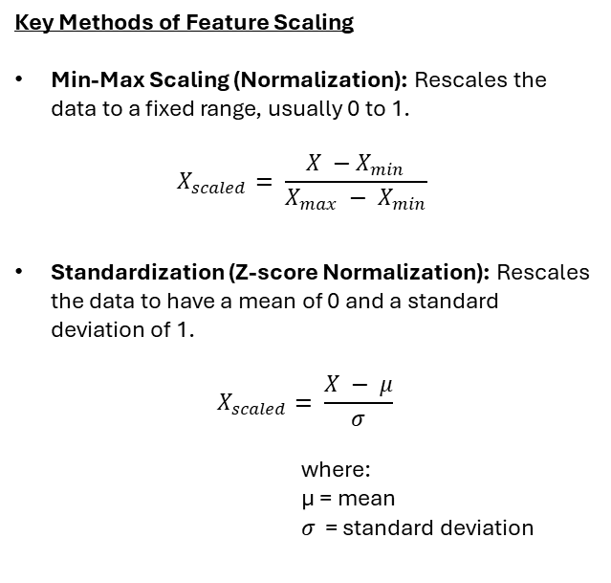
Key Concepts of Machine Learning
Feature Scaling
Key Methods of Feature Scaling
Min-Max Scaling (Normalization): Rescales the data to a fixed range, usually 0 to 1.
$$X_{scaled}= \frac{X −X_{min}}{X_{max} − X_{min}}$$
Standardization (Z-score Normalization): Rescales the data to have a mean of 0 and a standard deviation of 1.
$$X_{scaled}= \frac{X − μ}{σ}$$
where:
µ = mean
𝜎 = standard deviation
Importance of Feature Scaling
Improves Model Performance: Ensures that all features contribute equally to the result, preventing dominance by features with larger ranges.
Accelerates Convergence: Helps gradient-based algorithms to converge faster by providing a smoother and more stable optimization landscape.
Enhances Interpretability: Makes the model coefficients more interpretable by putting all features on a similar scale.
When to Apply Feature Scaling
Distance-Based Algorithms: K-nearest neighbors (KNN), K-means clustering.
Gradient-Based Algorithms: Linear regression, logistic regression, neural networks.
Principal Component Analysis (PCA): As it is sensitive to the variances of the features.

Slide 34
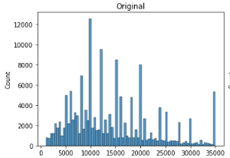
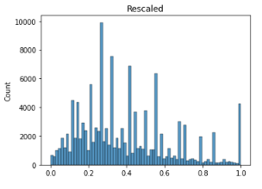
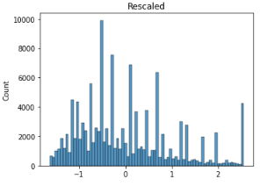
Key Concepts of Machine Learning
Feature Scaling
Key Methods of Feature Scaling
Min-Max Scaling (Normalization): Rescales the data to a fixed range, usually 0 to 1.
$$X_{scaled}= \frac{X −X_{min}}{X_{max} − X_{min}}$$
Standardization (Z-score Normalization): Rescales the data to have a mean of 0 and a standard deviation of 1.
$$X_{scaled}= \frac{X − μ}{σ}$$
where:
µ = mean
𝜎 = standard deviation
Min-max
Standardization

Slide 35
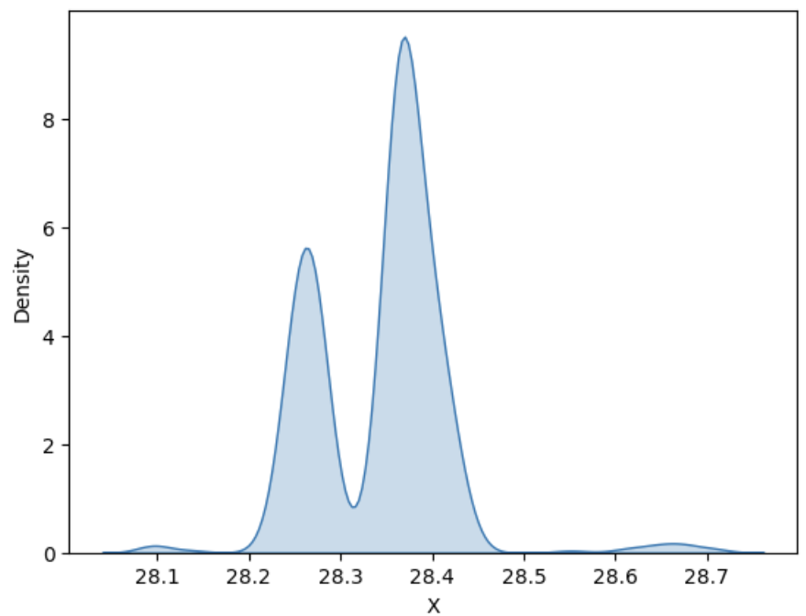
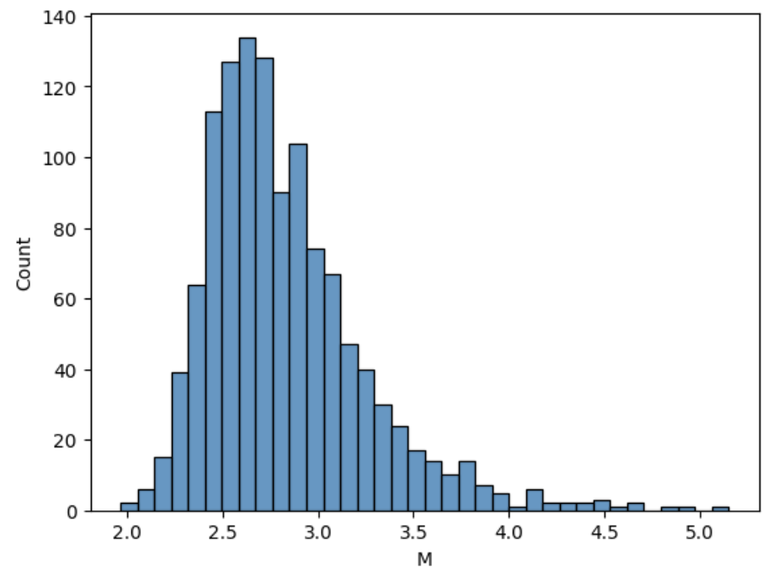
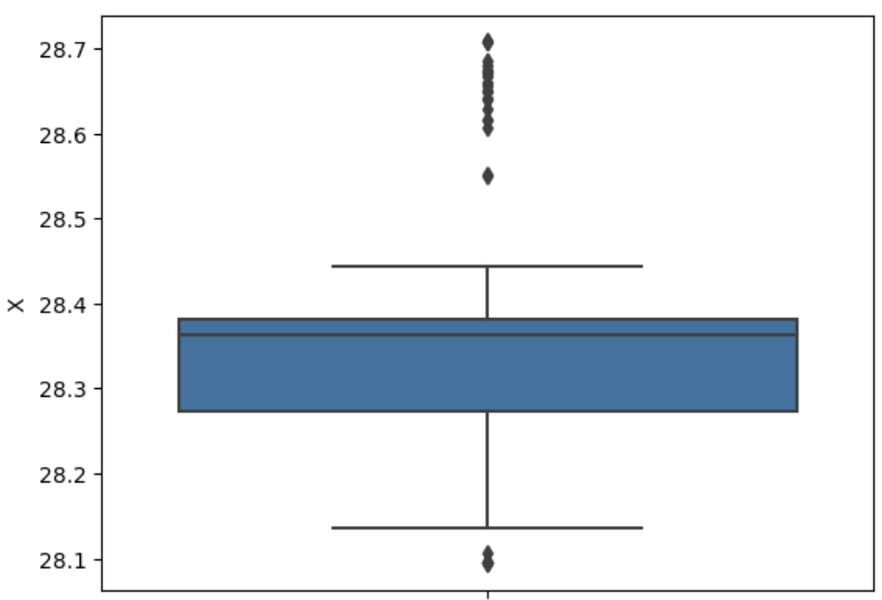
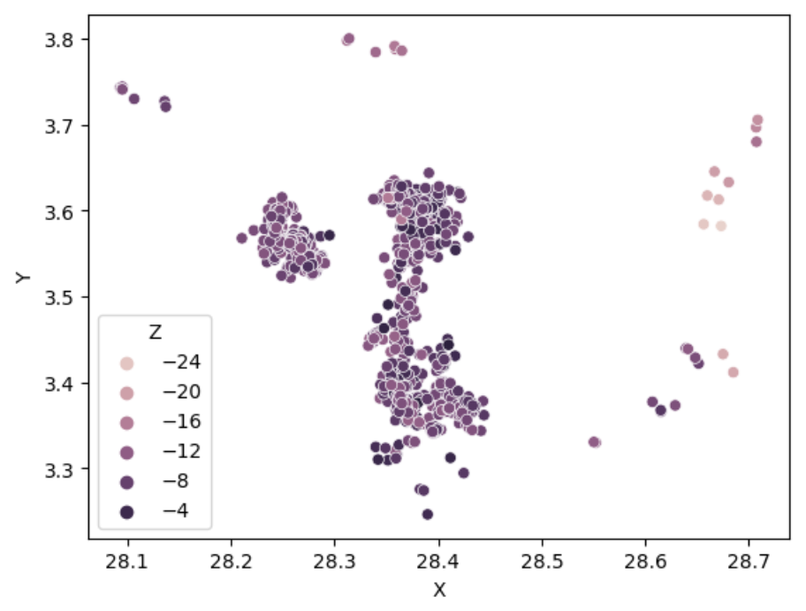
Key Concepts of Machine Learning
Exploratory Data Analysis (EDA)
EDA is one of the methods that is used to get to know our data. It is used by data scientists to analyze and investigate data sets and summarize their main characteristics, often employing data visualization methods. Understanding our dataset is critical when we want to model it or to perform further analysis. Several benefits of EDA are as follows:
to get a better understanding about a dataset
to know the characteristics of the dataset
to help make predictions and assumptions about the data
to find the patterns of the dataset as well as to catch mistakes / anomalies
to find any relationships in a dataset
Univariate and multivariate analysis are oftentimes used when it comes to performing EDA.
Univariate Analysis means an analysis performed on only a single variable (e.g. histogram / KDE plot / box plot)
in Multivariate Analysis, we compare two or more features to get the relationship between them. Hence, we can determine if one variable affects another variable (e.g. correlation coefficient)

Slide 36
Types of Machine Learning
Models and Algorithms
Machine learning
Supervised Learning
Semi-supervised learning
Reinforecement Learning
Classification
Labeled data
(continuous values)
Clustering
Dimensionality reduction
Labeled data
(discrete classes)
Unsupervised Learning
Regression
Unlabeled data
Combine labeled + unlabeled data
Classification
Regression
Association
Rewards & Penalties
Q-Learning
PCA
t-SNE
MDS
Apriori Algorithm
K-means clustering
Hierarchical clustering
Linear regression
Decision Tree regression
ANN
Polynomial regression
Logistic Regression
KNN
SVM
Random Forest
Markov Decision Process
Deep Q-Network
NOTE
Some ML models can be used for more than one purposes. For example, ANN can be used for regression as well as classification

Slide 37
Types of Machine Learning
Classification (SVM)
Regression (Linear)
Clustering (K-means)
x1
y
x1
x0
x
x0
Label A
Data point
Data point
Label B
Line of best fit
Cluster A
Hyperplane
Cluster B
Centroid for cluster A
Centroid for cluster B

Slide 38
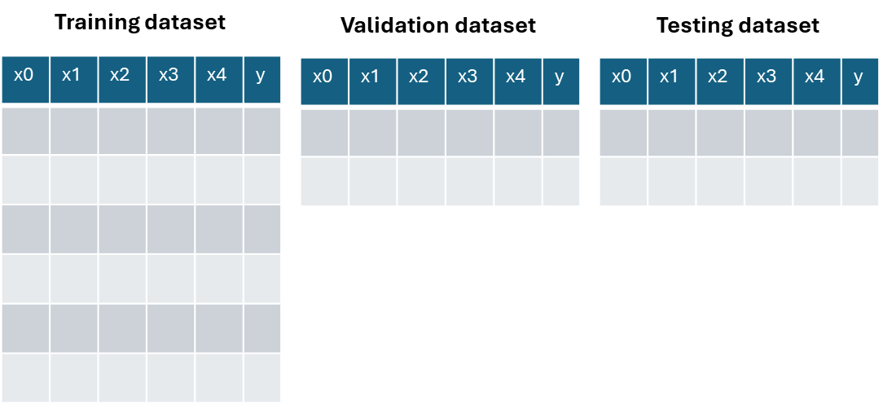
Key Concepts of Machine Learning
Model Evaluation and Validation
Model Validation Techniques
Train/Test Split: Dividing the dataset into two parts: one for training the model and one for testing its performance.
Cross-Validation: A technique where the data is divided into several subsets, and the model is trained and tested multiple times, each time with a different subset as the test set. Common methods include k-fold cross-validation and stratified k-fold cross-validation.
Data split into 3 partitions
Fold 1
Validation
Training
Training
Validation score 1
Fold 2
Training
Validation
Training
Validation score 2
Final score (average)
Fold 3
Training
Training
Validation
Validation score 3

Slide 39



Key Concepts of Machine Learning
Predicted
Model Evaluation and Validation
positive
negative
Classification Metrics
True positive | False negative
False positive | True negative
positive
Confusion Matrix: A table showing the number of true positives, true negatives, false positives, and false negatives
Accuracy: The ratio of correctly predicted instances to the total instances.
Precision: The ratio of true positive predictions to the total predicted positives.
Recall (Sensitivity): The ratio of true positive predictions to all actual positives.
F1 Score: The harmonic mean of precision and recall, providing a single metric that balances both concerns.
ROC-AUC (Receiver Operating Characteristic - Area Under Curve): A plot of the true positive rate against the false positive rate, with the area under the curve representing the model's ability to distinguish between classes.
Actual
negative
$$accuracy= \frac{tp+tn}{tp+tn+fp+fn}$$
$$precision= \frac{tp}{tp+fp}$$
$$recall= \frac{tp}{tp+fn}$$

Slide 40
Key Concepts of Machine Learning
Model Evaluation and Validation
Regression Metrics
Mean Absolute Error (MAE): The average absolute difference between predicted values and actual values.
Mean Squared Error (MSE): The average squared difference between predicted values and actual values.
Root Mean Squared Error (RMSE): The square root of MSE, providing error in the same units as the response variable.
R-squared (R²): The proportion of variance in the dependent variable that is predictable from the independent variables, indicating how well the model fits the data.

Slide 41
Some excellent sources of information
Eric Matthes (2019) - Python Crash Course_ A Hands-On, Project-Based Introduction to Programming-No Starch Press
Chollet, F. (2018): Deep learning with Python, Manning Publication

Slide 42
Thanks!

